Slide 1
Data Structure for recursion

Slide 2
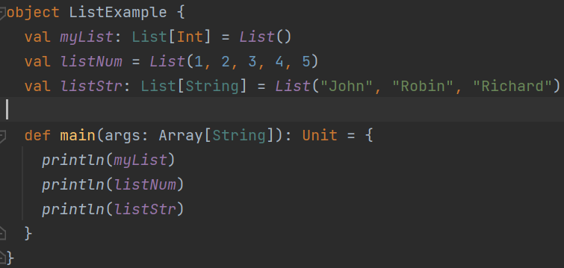
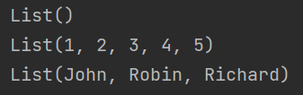
List
Immutable
Linked list
Notes:
object ListExample { val myList: List[Int] = List() val listNum = List(1, 2, 3, 4, 5) val listStr: List[String] = List("John", "Robin", "Richard") def main(args: Array[String]): Unit = { println(myList) println(listNum) println(listStr) } }

Slide 3

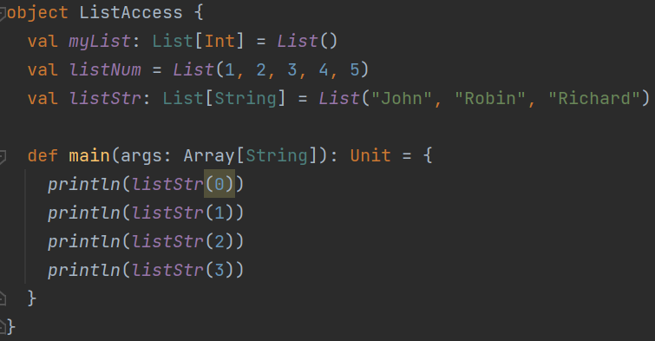
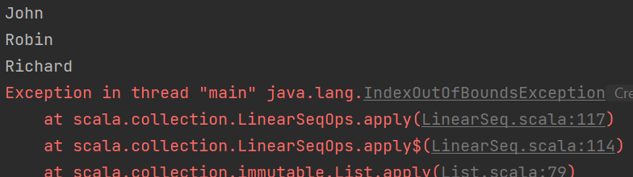



List access
Notes:
object ListAccess { val myList: List[Int] = List() val listNum = List(1, 2, 3, 4, 5) val listStr: List[String] = List("John", "Robin", "Richard") def main(args: Array[String]): Unit = { println(listStr(0)) println(listStr(1)) println(listStr(2)) println(listStr(3)) } }

Slide 4









How to define a list?
Use a cons
List of the rest of data
First data
Anything in front or between it must be a data.
Notes:
object ListAccess { val myList: List[Int] = List() val listNum = List(1, 2, 3, 4, 5) val listNum2 = List(1, 2, 3, 4, 5) val listStr: List[String] = List("John", "Robin", "Richard") def main(args: Array[String]): Unit = { val listStr2 = "Will" :: listStr println(listStr2) val listNum2 = 9 :: 6 :: 17 :: Nil println(listNum2) println(listNum ++ listNum2) } }

Slide 5




Slide 6
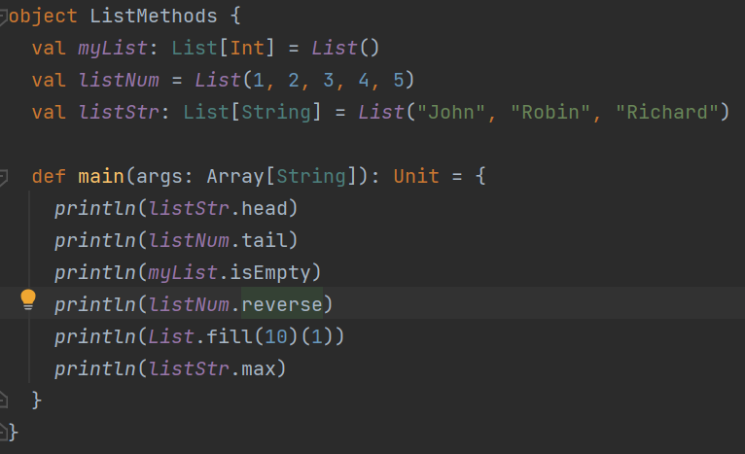
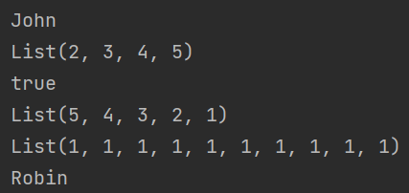
List methods
Notes:
object ListMethods { val myList: List[Int] = List() val listNum = List(1, 2, 3, 4, 5) val listStr: List[String] = List("John", "Robin", "Richard") def main(args: Array[String]): Unit = { println(listStr.head) println(listNum.tail) println(myList.isEmpty) println(listNum.reverse) println(List.fill(10)(1)) println(listStr.max) } }

Slide 7




Exercise (only isEmpty, length, head, tail, ::, ++ available)
Notes:
member 2 นาที
Sorted 2 นาที
Delete 1 นาที
length 1 นาที
def member(x:Any , l :List[Any]): Boolean ={ if(l.isEmpty) return false if(l.head == x) return true member(x,l.tail) }
-------------------------------------
def sorted(l: List[Int]):Boolean = { if(l.isEmpty || l.length ==1) return true return ((l.head <= (l.tail).head) && sorted(l.tail)) } def sortedTailRec(l: List[Int]):Boolean= { if(l.isEmpty || l.length ==1) return true if((l.head > (l.tail).head)){ return false; }else{ return sortedTailRec(l.tail); } }
-----------------------------------
def delete(x: Any, l: List[Any]): List[Any] = { if (l.isEmpty) List() else if (x == l.head) delete(x, l.tail) else l.head :: delete(x, l.tail) } ////////////////////////////////////////////////// def deleteOptimize(x: Any, l: List[Any]): List[Any] = { return deleteTailRec(x, l, List()) } def deleteTailRec(x: Any, l: List[Any], acc: List[Any]): List[Any] = { if (l.isEmpty) { return acc; } if (x == l.head) { return deleteTailRec(x, l.tail, acc); } else { return deleteTailRec(x, l.tail, acc ++ List(l.head)) } }
------------------------------------
def length(l:List[Any]):Int ={ if(l.isEmpty) 0 else 1 + length(l.tail) } //////////////////////////////////////////// def lengthOptiMize(l:List[Any]): Int = { return length2(l,0) } def length2(l:List[Any], acc:Int):Int ={ if(l.isEmpty) return acc; else length2(l.tail,acc+1) }

Slide 8





Exercise - cont
Notes:
myReverse 3 นาที
Dot
Max
Setify
------------------
def myReverse(l: List[Any]): List[Any] ={ if(l.isEmpty) return List() //append(myReverse(l.tail), List(l.head)) myReverse(l.tail) ++ List(l.head) } /////////////////////////////////// def myRevOpt(l:List[Any]): List[Any] ={ return myReverseTailRec(l,List()) } def myReverseTailRec(l: List[Any], acc:List[Any]): List[Any] ={ if(l.isEmpty) return acc return myReverseTailRec(l.tail, List(l.head) ++ acc) }
-----------------------------------------
def dot(l1:List[Int],l2:List[Int]):Int ={ if(l1.isEmpty || l2.isEmpty) 0 else l1.head * l2.head + dot(l1.tail,l2.tail) } def dotAcc(l1:List[Int],l2:List[Int],acc:Int):Int ={ if(l1.isEmpty || l2.isEmpty) acc else dotAcc(l1.tail,l2.tail, acc + (l1.head * l2.head)) }
-------------------------------------------------
def maxN(l:List[Int]):Int ={ // if(l.isEmpty) throw Exception if(l.length ==1) return l.head var m = maxN(l.tail) if(l.head > m) l.head else m } def maxx(l:List[Int],acc:Int) : Int ={ if(l.isEmpty) acc else if(l.head > acc){ maxx(l.tail,l.head) }else { maxx(l.tail,acc) } } def max(l:List[Int]):Int = { maxx(l,l.head) }
-----------------------------------
def setify(l:List[Any]):List[Any] ={ if(l.isEmpty) return List() if (member(l.head,l.tail)){ return setify(l.tail) }else{ return l.head :: setify(l.tail) } } ////////////////////////////////// def setifyOpt(l:List[Any]):List[Any] ={ return setifyTailRec(l,List()) } def setifyTailRec(l: List[Any], acc: List[Any]): List[Any] = { if(l.isEmpty) return acc; if(member(l.head,l.tail)){ return setifyTailRec(l.tail,acc) } else { return setifyTailRec(l.tail, acc++ List(l.head)) } }

Slide 9
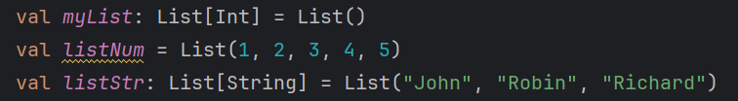
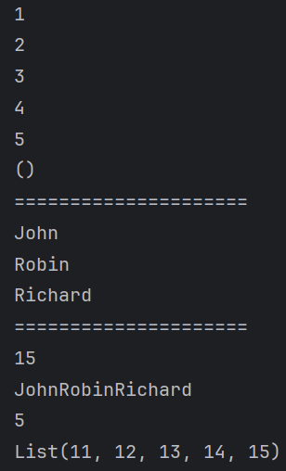
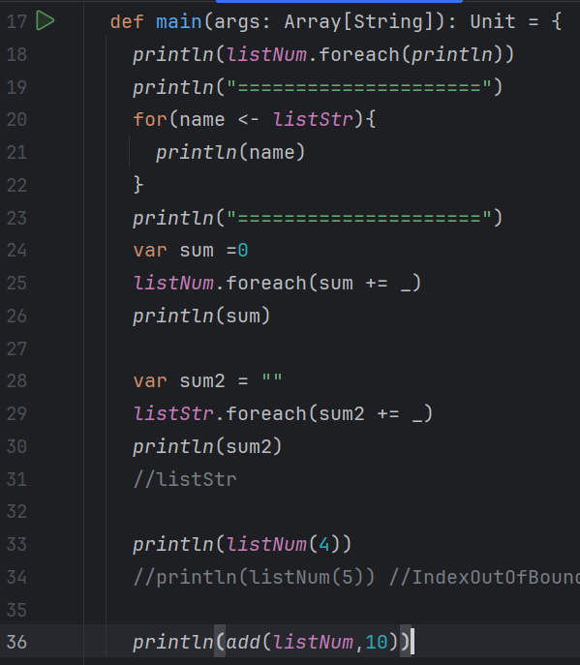




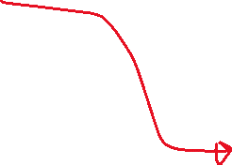
List iteration
Notes:
object ListIterate { val myList: List[Int] = List() val listNum = List(1, 2, 3, 4, 5) val listStr: List[String] = List("John", "Robin", "Richard") def add(s:List[Int], a:Int): List[Int] = { if(s.isEmpty) { return List() } (s.head+a) :: add(s.tail,a) } def main(args: Array[String]): Unit = { println(listNum.foreach(println)) println("=====================") for(name <- listStr){ println(name) } println("=====================") var sum =0 listNum.foreach(sum += _) println(sum) var sum2 = "" listStr.foreach(sum2 += _) println(sum2) //listStr println(listNum(4)) //println(listNum(5)) //IndexOutOfBoundException println(add(listNum,10)) } }

Slide 10
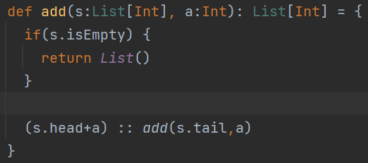


Iterate to modify a list?
Cannot be done because list is immutable.
We have to produce a new list.
Notes:
bject ListIterate { val myList: List[Int] = List() val listNum = List(1, 2, 3, 4, 5) val listStr: List[String] = List("John", "Robin", "Richard") def add(s:List[Int], a:Int): List[Int] = { if(s.isEmpty) { return List() } (s.head+a) :: add(s.tail,a) } def main(args: Array[String]): Unit = { println(listNum.foreach(println)) for(name <- listStr){ println(name) } var sum =0 listNum.foreach(sum += _) println(sum) println(listNum(4)) // println(listNum(5)) IndexOutOfBoundException println(add(listNum,10)) } }

Slide 11
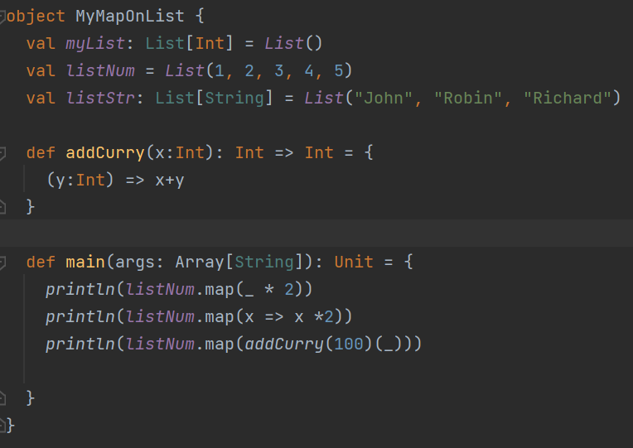
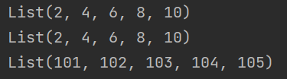
Higher order methods MAP
Notes:
object MyMapOnList { val myList: List[Int] = List() val listNum = List(1, 2, 3, 4, 5) val listStr: List[String] = List("John", "Robin", "Richard") def addCurry(x:Int): Int => Int = { (y:Int) => x+y } def main(args: Array[String]): Unit = { println(listNum.map(_ * 2)) println(listNum.map(x => x *2)) println(listNum.map(addCurry(100)(_))) } }

Slide 12
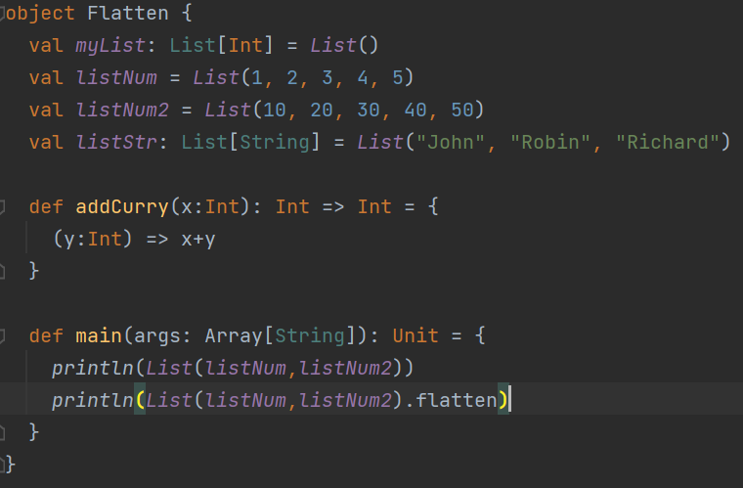

flatten
Notes:
object Flatten { val myList: List[Int] = List() val listNum = List(1, 2, 3, 4, 5) val listNum2 = List(10, 20, 30, 40, 50) val listStr: List[String] = List("John", "Robin", "Richard") def addCurry(x:Int): Int => Int = { (y:Int) => x+y } def main(args: Array[String]): Unit = { println(List(listNum,listNum2)) println(List(listNum,listNum2).flatten) } }

Slide 13
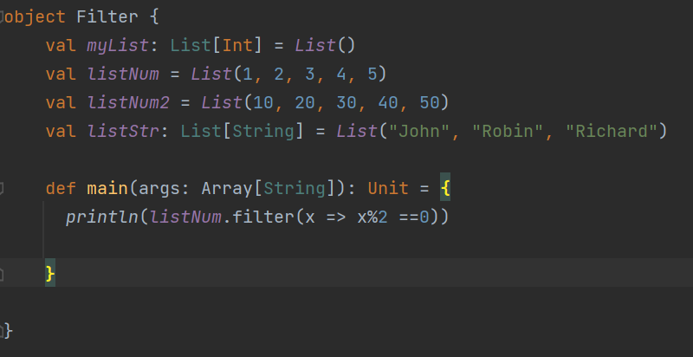

Filter
Notes:
object Filter { val myList: List[Int] = List() val listNum = List(1, 2, 3, 4, 5) val listNum2 = List(10, 20, 30, 40, 50) val listStr: List[String] = List("John", "Robin", "Richard") def main(args: Array[String]): Unit = { println(listNum.filter(x => x%2 ==0)) } }

